Slide 1
The Early Colonial Period of American Literature
1607-1765

Slide 2
The Beginning and End
1765 The Stamp Act starts the American Revolution
1607 - Jamestown is settled
Characteristics of Literature in the Colonial Period
Influenced heavily by British writers
Consists mostly of Historical and Teaching materials
Reverence for the Bible
Reflected the public’s religious views

Slide 3
The Plymouth Colony
Settled by the Pilgrims (Puritans) in 1620
Leader was William Bradford
Operated under the Mayflower Compact
This meant that they had social, religious, and economic freedom, but maintained their ties to Britain.

Slide 4
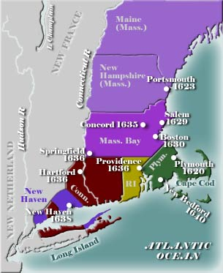
The Massachusetts Bay Colony
Settled by PURITANS
John Winthrop is their leader
Operated under the Arabella Covenant- which meant they were free of British control.
the requirement for getting a vote in government was membership in the church, not land ownership as was the case in other colonies.

Slide 5
Basic Puritan Beliefs
Total Depravity- because of Adam’s fall everyone is born sinful (This is the concept of Original Sin)
Unconditional Election- God “saves” those he wishes, only a few are selected for salvation (Concept of Predestination)
Limited Atonement- Jesus died for the chosen only, not for everyone.
Irresistible Grace- God’s grace is freely given, it cannot be earned or denied.
Perseverance of the Saints- those elected by God have full power to interpret the will of God, and to live uprightly. If anyone rejects grace after feeling its power in his life, he will be going against the will of God, something impossible in Puritanism.
MANIFEST DESTINY- “City on a hill” we are to set the example for the rest of the world.

Slide 6
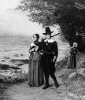
The Function of Puritan Writers
Transform a mysterious God- mysterious because he is separate from the world.
To make God more relevant to the Universe.
To glorify God.

Slide 7
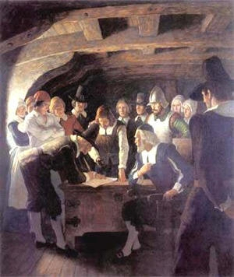
The Style of Puritan Writing
Protestant- reverence for the bible.
Purposefulness- there was a purpose to Puritan writing.
Puritan writing reflected the character and scope of the reading public, which was literate and well-grounded in religion.

Slide 8
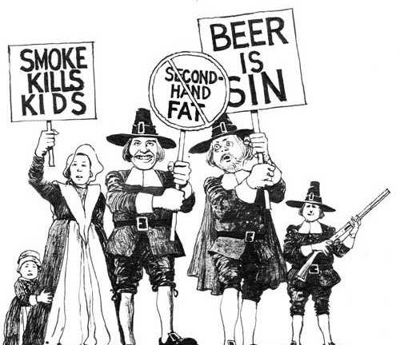
Common Themes in Early Puritan Writing
Idealism- (presenting things as they should be rather than as they are) both religious and political
Pragmatism- practicality and purposefulness

Slide 9
Forces Undermining Puritanism
A person’s natural desire to “do good”- this works against predestination.
Dislike of a “closed” life.
Resentment of the power of the few over the many.
Change in economic conditions- growth of fisher, farms, etc.
The presence of the frontier- concept of self- reliance, individualism, and optimism.
Lack of flexibility.
Growth of rationality- use of the mind to know God- less dependence on the Bible.

Slide 10
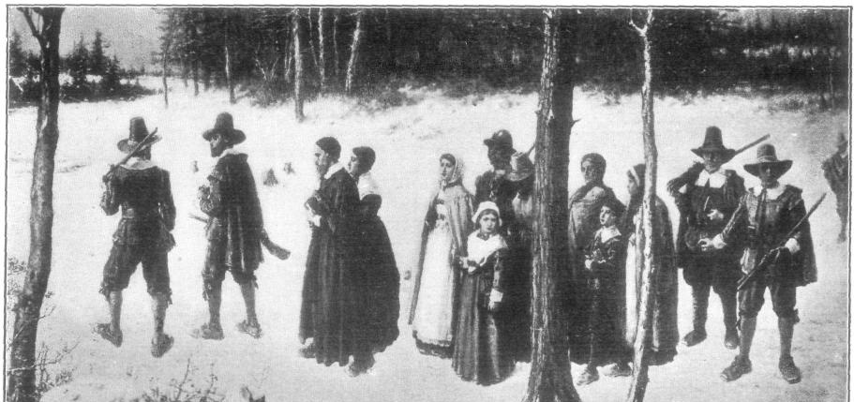
Visible signs of Puritan Decay
Visible decay of godliness.
Manifestations of pride- especially among the new rich.
Presence of “heretics’- Quakers and Anabaptists.
Violations of the Sabbath and swearing and sleeping during sermons.
Decay in family government
People full of contention- rise in lawsuits and lawyers.
Sins of sex and alcohol on the increase.
Decay in business morality- lying , laborers underpaid, etc.
Lacking in social behavior.

Slide 11
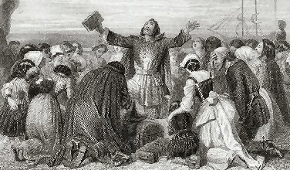
Lasting Aspects of the Puritan Legacy
The need for moral justification for private, public, and governmental acts.
The Questing for Freedom- personal, political, economic, and social.
The Puritan work ethic.
Morbid fascination with death.
The city upon the hill- concept of Manifest Destiny.

